Slide 1

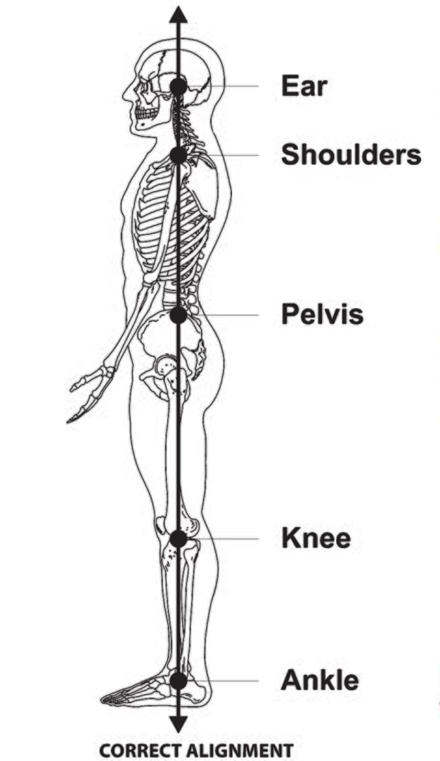
Artificial Intelligence (AI) Based Human Pose/Posture Detection System
Elevate your understanding of proper posture with AI-based human pose/posture detection system. Learn how AI technology revolutionizes posture detection.
DG
by Dhanesh Gore

Slide 2
Types of AI-Based Human Pose/Posture Detection Systems
RGB Camera-Based Systems
Depth Camera-Based Systems
Sensor-Based Systems
Utilize computer vision algorithms to analyze body positions and orientations from RGB camera data.
Use depth sensors to accurately capture body dimensions and movements, enabling enhanced posture analysis.
Integrate various sensors, such as accelerometer and gyroscope, to capture body movements and detect posture abnormalities.

Slide 3


Applications of AI-Based Human Pose/Posture Detection Systems
1
Healthcare and Rehabilitation
2
Gaming and Virtual Reality
Enable real-time monitoring of patients' postures, aiding in rehabilitation exercises and preventing musculoskeletal disorders.
Enhance immersive experiences by capturing users' body poses for gesture-based controls and realistic avatars.
3
Sports and Fitness
Improve athletic performance by analyzing and correcting athletes' postures during training sessions.

Slide 4

Challenges and Limitations of AI-Based Human Pose/Posture Detection Systems
1
Accuracy and Precision
2
Environmental Factors
3
Real-Time Processing
Ensuring robust and accurate detection of complex postures in various scenarios and environments.
Accounting for lighting conditions, occlusions, and background interferences that affect posture detection accuracy.
Optimizing algorithms to process pose data in real-time for immediate feedback and responsiveness.

Slide 5
Future Developments and Trends in AI-Based Human Pose/Posture Detection Systems
1
Advanced Deep Learning Algorithms
Continued research and innovation in deep learning techniques to further improve posture recognition accuracy.
Integration with Wearable Devices
2
Seamless integration of posture detection technology into wearable devices for personalized posture monitoring.
3
Multi-modal Approaches
Combining data from multiple sensors and modalities for more comprehensive and precise posture analysis.

Slide 6
Conclusion
Recap of Main Points
Potential Impact of AI
Importance of Continued Research
AI-based human pose/posture detection systems offer valuable insights into proper body alignment and movement.
By improving posture, individuals can prevent health issues and enhance overall well-being and confidence.
Ongoing exploration and advancement in AI-based posture detection technology will unlock further benefits.

